Slide 1

Itaú PRR
Working Backwards Recap
Fernando Moribe & Noah Pashley
May 25, 2021

Slide 2



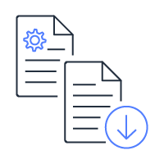
PRR working backwards executive summary
Teams from Itaú and AWS came together to innovate the PRR experience the Amazon way, by working backwards from the architects and engineers using PRR as we ideate and design bar raising experiences that delight and exceed their expectations. The group collaborated in 12 hours of workshops to dive deep and understand the challenges and opportunities in the PRR process while designing a future state automated PRR experience that supports architects and the business’s goal of 60% applications migrated & modernized in production on AWS.
Architect goals
Top challenges architects have today
The solution
Deploy applications to production
Confusing, manual PRR process
Continuous, automated
PRR reviews
Clear path to issue resolution
Time consuming preparation & PRR review
Business goals
Migrate or modernize 60% of workloads by end of 2021
Unclear path to resolving issues
Real-time PRR alerts & notifications
Support and templates to leverage

Slide 3
PRR working backwards recap
Detailed deep dive recap

Slide 4
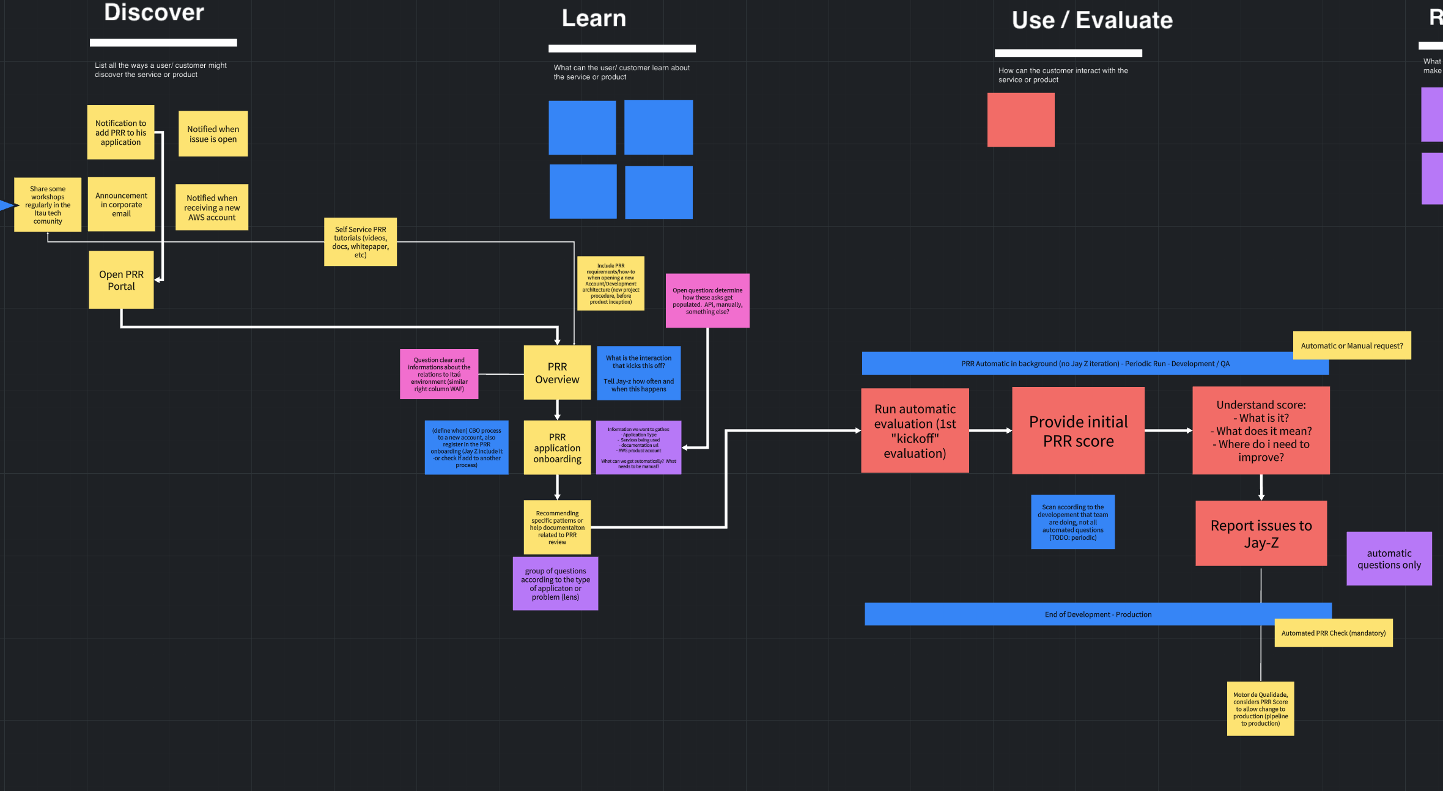
Working backwards summary
May 12 - May 18
Itaú and AWS co-created the automated PRR experience in a collaborative tool to explore the possible and design experiences that raise the bar for Itaú PRR users and business teams.
Activities
5 customer questions
Persona identification & build out
Empathy mapping
Problem opportunity
Customer solution
Components of the PR
FAQ creation

Slide 5
The 5 customer questions
PRR working backwards deep dive recap
We started working backwards by asking 5 questions that align us to the customer opportunity:
Who is the customer? Itaú architects & engineers pushing applications to production
What is the customer problem or opportunity? Get applications to production quicker through the evaluation based on the well-architected framework
What is the most important customer benefit? Review and approve applications and services with speed
How do you know what the customer needs or wants? Current process is time consuming and is a blocker to getting applications to production quickly
What does the customer experience look like? An automated PRR experience enabling teams to evaluate and deploy their services securely and confidently, with speed.

Slide 6

Persona identification & build out
PRR working backwards deep dive recap
The team identified a key customer of the PRR team and dove deep to understand the needs of this persona.
Beliefs & behaviors
Pain points
Shawn Carter
Believes that simple is better
Develops and deploys services and applications for Itaú
Believes it takes too long to get applications to production
PRR assessment takes too long
Stressed when applications go down
Investing too much time in the PRR process (2 weeks per pillar. About 1 month total)
Managing governance bureaucracy
PRR technical debt backlog produced as a result of the PRR review
Itaú architect
Bio
Shawn is a 37 year old architect at Itaú with almost 15 years of experience in the field. He works with his teams on building
Goals
Motivations
Deploy applications to production
Anticipate problems that may come up through the PRR process
Leverage the best practices for high quality and reliable workloads
Speed. Speed. Speed.
Being recognized for his and his team’s work
Getting the job done quickly with high quality
Constantly improving
Quote
"Deploying services today can take awhile and I just don't know where to start."

Slide 7
Empathy mapping
PRR working backwards deep dive recap
Empathy mapping enabled the team to understand Shawn’s needs deeper that we need to solve for.
Says
Thinks
Pains
“I don’t know what you expect out of this question.”
“Why does PRR have so many questions in the process?”
Is this process worth it?
This process is taking way too much time.
Time consuming
Many people involved in the process
“Sorry, I have to drop to another meeting.”
“How do I resolve this tech debt?”
Oh great! Another issue to my backlog...
Wonder what would happen if I skipped the PRR review
Confusing
“Won’t the PRR process just bring us more cost?”
Will my product be more reliable after this process?
Should have started this earlier
Adds work and effort
Gains
Taking notes
Trying to reach different people to answer the questions
Shawn Carter
Excited for production release
Disappointed the PRR process slowed the progress to production
Quality services in production
Itaú architect
Cost optimized solutions
Gather information and reference material for the PRR review
Redirect questions to another team
Bored by spending so much time in interview
Confident the product will now be within the bank’s security parameters
Decreases operational tasks
Providing evidence to the questions being asked
Preparing for the upcoming PRR assessment
Anxious due to deadlines
Insecure
Running products with confidence
Does
Feels

Slide 8
Problem opportunity
PRR working backwards deep dive recap
Once the team aligned on the needs of Shawn, the team mapped out the challenges Shawn faces throughout the PRR process.
Prepare
Evaluate
Resolve
Why am I just now going through this?
Unclear purpose to questions
Clearing out time on my team's calendar for these reviews is challenging
Not sure how to prioritize PRR tech debt with new product features
When should I do the PRR review?
Priority of PRR issues. What should I focus on first?
So many documents to pull together for the PRR review
This doesn't apply for my workload/product
Missing documentation
Have difficulty to answer the questions
Looking for answers to my doubts
Need to meet Itau standards
How much prep time is needed to prepare for PRR so I know where to plan it in my Sprint plan.
Challenge figuring out how to solve an issue
Time consuming
Takes time to cover the gaps discovered during the PRR review
What or how many resources are needed from our Pod to have successful PRR.

Slide 9
Customer solution
PRR working backwards deep dive recap
The team brainstormed future state opportunities to raise the bar when delivering an automated PRR experience.
Prepare
Evaluate
Resolve
Deploy
Scheduled PRR (every 15 days or so? running in the background?)
Show incremental PRR improvements
Automated action plan
A page to consult the scores, evolves and pending action plans.
Continuous evaluation
Automated prioritization of gaps
Chat with Alexa. how do I resolve this? what resources are available?
Correlation between gaps and deployments
Automated assessment
PRR done in 5 minutes
Have a documentation of knowledges from previous PRR solutions applied
Self service
Different Lens (user can choose what kind of questions should be applied)
Backlog calculator. Show me the cost of addressing tech debt could actually save me money!
Define standards with the responsible teams
Documentation/Examples on how to solve mapped gaps

Slide 10
Components of the PR
PRR working backwards deep dive recap
Every press release (PR) has key components to it. The team crafted messages that will inform the PR that drives the vision.
Headline
Production Readiness Review (PRR) introduces Automated Reviews: A simple continuous automated review process to uncovering reliability gaps and building a prioritized action plan for product engineering teams deploying applications to production.
Customer quote
PRR business quote
“I don't need to spend time on exhausting meetings to fill the PRR/WAF anymore. The automated review brings the same quality faster!”
“The overview dashboard makes it easier to understand my PRR Score.”
"Now our team has more time to focus on solutions that will reach more teams/pods than interviewing one at a time”
“With PRR, we are able to scale maturity to all bank.”
Call to action
Automated PRR is now available for new AWS accounts, get to know your problems before they get to you. Faster and easier than the old PRR process, get your score and action plans within minutes. For more information, check our Confluence page

Slide 11
FAQ creation
PRR working backwards deep dive recap
FAQs encourage the team to look at the solution from every angle. The team populated a list of FAQs that they felt we need to get answers to as we build out the solution.
FAQ ideation
What is the PRR review?
How long are the reviews?
How do I start the review?
How do I follow up on improvements?
How can I check my workload milestones?
When does the automation run within my workload?
What is a score?
What’s the score formula?
What is the minimum acceptable score?
What do we do if we don’t reach the minimum score?
Do I have to use the PRR process?
What is the automated PPR based on?
How can I bypass a verification hat isn’t applicable to me?
What if the action plan doesn’t apply to my workload?
How can I invoke the automation in my workload?
How can I fix issue ID PRR12345?
What is the PRR score threshold?
Where can I check all the questions around technical documentation?
Is PRR a blocker to deploy in production?
How does the PRR check my workload?
Is PRR a one time review?
What team is responsible for the PRR?
Does the score of maturity fit the governance of quality in any area of the bank?
I just pushed my first release to production. Why is my score so low?
I fixed the issues identified by PRR. How long does it take for my score to update?

Slide 12
PR/FAQ/Visuals
Working backwards outputs

Slide 13
Key artifacts to working backwards
PRR working backwards outputs
Outputs from the working backwards session inform the 3 key artifacts that align the team to the customer vision.
?
Press Release
FAQ
Visuals
Our north star vision aligning to customer needs.
Identifying the areas we need to solve for and any gaps.
Defining what the customer experience is and how customers interact with it.

Slide 14
Press release (PR)
PRR working backwards outputs
Insert PRR screenshot and link to the document

Slide 15
Frequently asked questions (FAQ)
PRR working backwards outputs
Insert PRR screenshot and link to the document

Slide 16
Visuals
PRR working backwards outputs
The team identified two types of situations user may be in when interacting with PRR that we need to account for.
PRR for new products
Discover
Learn
Use/Evaluate
Resolve
PRR for existing products

Slide 17
Visuals | PRR for new products
PRR working backwards outputs
Discover
Learn
Use/Evaluate
Resolve
Coming soon

Slide 18
Next steps
Build the PRR experience

Slide 19
Next steps
Review – Come together to dive deep on the working backwards artifacts and provide feedback.
Refine – Take feedback to raise the bar for the customer vision.
Build – Pick the first right thing that the team can build for the customer experience.

Slide 20
Obrigado!
Thank you!

